Slide 1



Therminator: A Thermal Simulator for Smartphones Producing Accurate Chip and Skin Temperature Maps
Qing Xie, Mohammad Javad Dousti,
and Massoud Pedram
University of Southern California
ISLPED 2014, 08/11/2014

Slide 2
Outline
Motivation
  Thermal challenge for smartphones
  Design time thermal simulator
Therminator
  Overview
  Compact thermal modeling
  Temperature results validation
  Parallel computing feature
Case study on Samsung Galaxy S4
  Impact of skin temperature setpoint
  Impact of thermal characteristics of materials
Conclusion

Slide 3
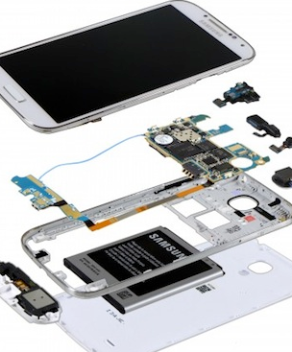
Motivation
Smartphones are getting “hot”
  Not only the popularity, but also the temperature
  Higher power density
  Smaller physical size
    Components are close to each other
    No active cooling mechanism
Thermal challenges
  Conventional thermal constraint
    Maximum junction temperature (T_{j})
    Application processor is the major
    heat generator in the mobile device
    Typical critical temperature as high as 85 ~ 100˚C
    High die temperature
      High leakage, fast aging, etc.
  A new thermal constraint !
Breakdown of Samsung Galaxy S3

Slide 4
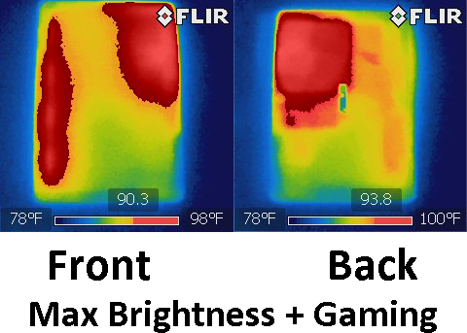
Thermal Challenge Smartphones
Thermal challenge, cont’d
  A new thermal constraint
    Maximum skin temperature
    Skin temperature –
    the hotspot temperature on
    the surface of mobile devices
    Typical critical temperature
      45˚C
    High skin temperature
      Bad user experience, or even burn users
  Apple iPad3 hits 46.7˚C !! – by consumer reports
  Modern smartphone manufacturers put a lot of efforts on improving the thermal design
    Determine the most appropriate location, size, material composition of thermal pads
Thermal images of Asus Transformer TF300

Slide 5
Design Time Thermal Simulator
A good thermal simulator at the design time
  Generate temperature maps for different components in mobile devices
    Application processor, front screen, rear case, battery, etc.
  Optimize the thermal path design
    Material composition, 3D layout, etc.
  Optimize the thermal management policy
    Control setpoint, control step-size, etc.
Computational Fluid Dynamics (CFD) tool
  Expensive license
  Slow for large input size
Develop a compact and integratable tool
  Compact thermal modeling
  Easy to integrate with other performance simulators

Slide 6
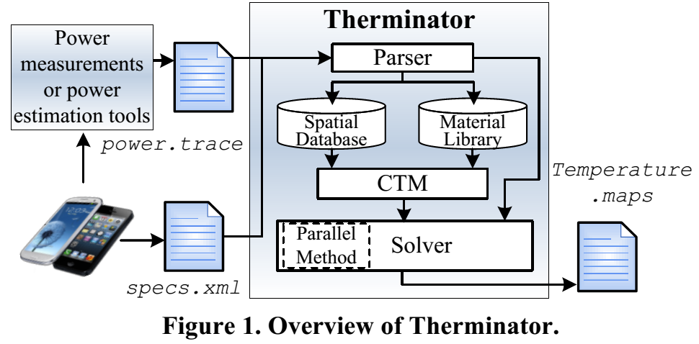
Overview of Therminator
Therminator – a thermal simulator for smartphones
Inputs:
  Design_specification.xml
    3D layout
    Material composition
  Power.trace
    Power consumption of major components
Output:
  Temperature maps
    Temperature
    distribution for
    each component

Slide 7
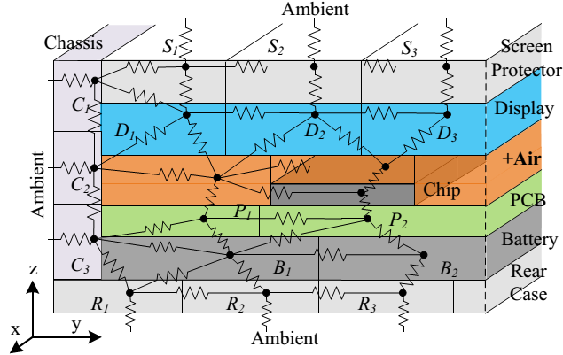
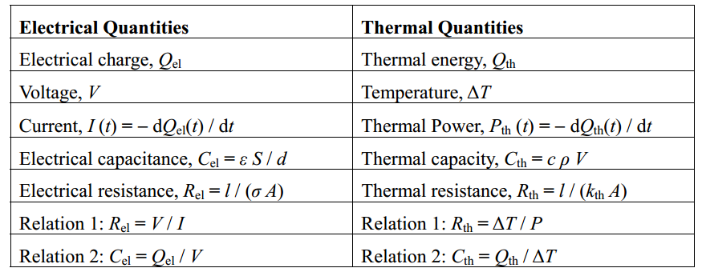
Compact Thermal Modeling
Compact thermal modeling
  Based on duality between the thermal and electrical phenomena
  Accurate, fast response
  Solve KCL-like equations for temperatures
  Produce transient results
Therminator builds the thermal resistance network automatically
  Detect adjacent sub-components
  Calculate thermal resistance
  Void fill with air
    Avoid trivial solution

Slide 8



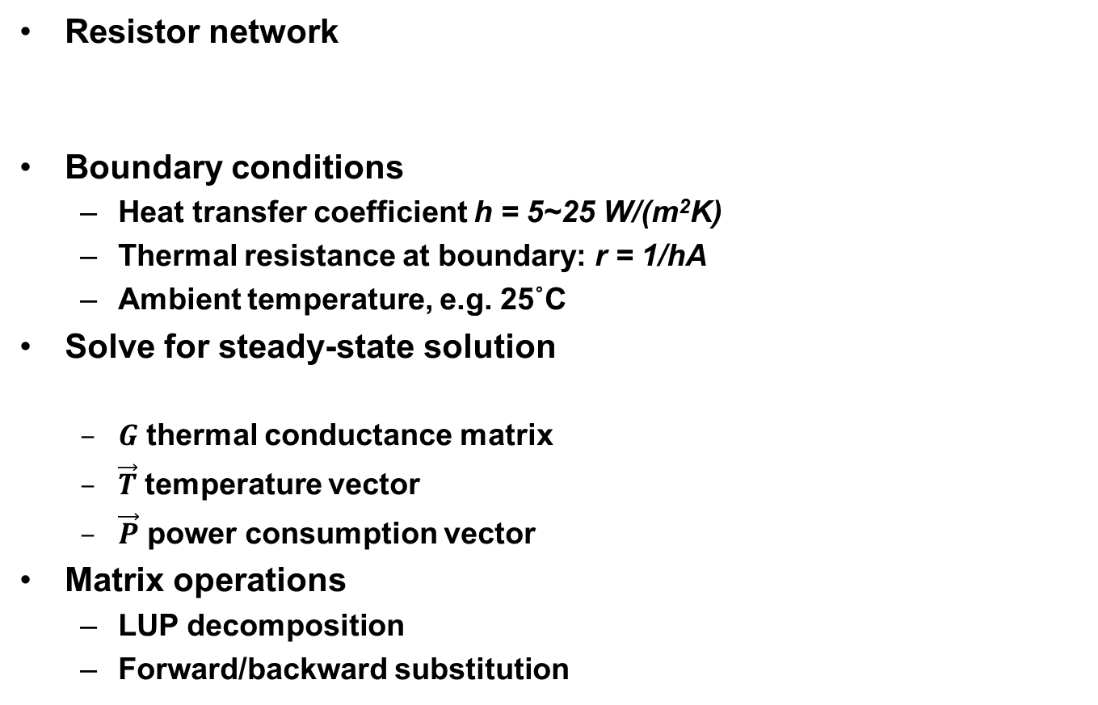
Solving the CTM
Resistor network
Boundary conditions
  Heat transfer coefficient h = 5~25 W/(m²K)
  Thermal resistance at boundary: r = 1/hA
  Ambient temperature, e.g. 25˚C
Solve for steady-state solution
  $G$ thermal conductance matrix
  $\vec{T}$ temperature vector
  $\vec{P}$ power consumption vector
Matrix operations
  LUP decomposition
  Forward/backward substitution
$$G\vec{T}=\vec{P}$$

Slide 9
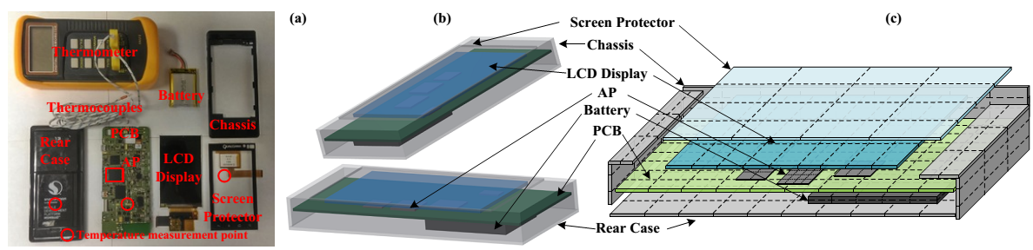
Temperature Results Validation
Target device
  Qualcomm Mobile Development Platform (MDP)
  A provided power profiler
    Generate power consumption breakdown
Validate Therminator against
  Real measurements: thermocouple, register access
  CFD simulation
  Temperatures at:
    PCB, rear case, front screen, Application Processor (read register)

Slide 10
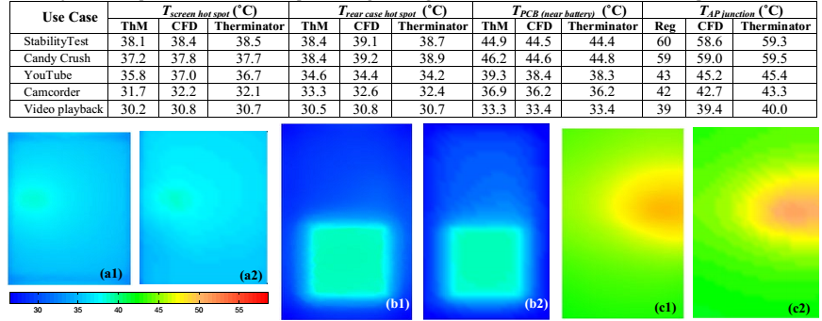
Temperature Results Validation
Temperature results
  Various usecases
  Real measurement vs. CFD
    Maximal error – 11.0% [AP], average error – 2.7%
  CFD vs. Therminator
    Maximal error – 3.65%, average error – 1.42%

Slide 11
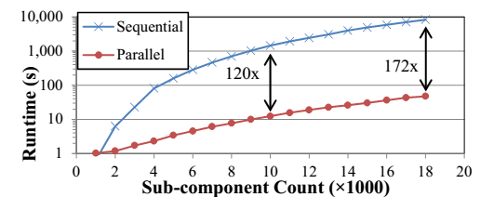
Implementation of Therminator
Parallel computing feature
  Utilizing GPU to speedup
    CULA Dense library
  Up to 172X runtime speed up
    4X Intel Xeon E7-8837 processors
      10 mins
    4×Intel Xeon E7-8837 processors + NVIDIA Quadro K5000 GPU
      a few seconds

Slide 12
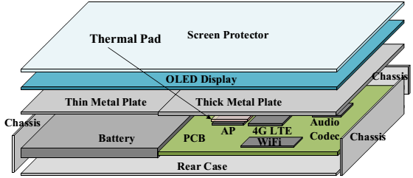
Case Study on Samsung Galaxy S4
Target device
  Samsung Galaxy S4 (2013)
    Quad-core Snapdragon 600 (1.9GHz)
    Adreno 320 GPU, 2G LPDDR3
    5” AMOLED display
  Power consumption trace
    Accurate break-down measurement is not possible
    Obtain from another work studying this device [Chen’13]
  A simplified model of Galaxy S4

Slide 13
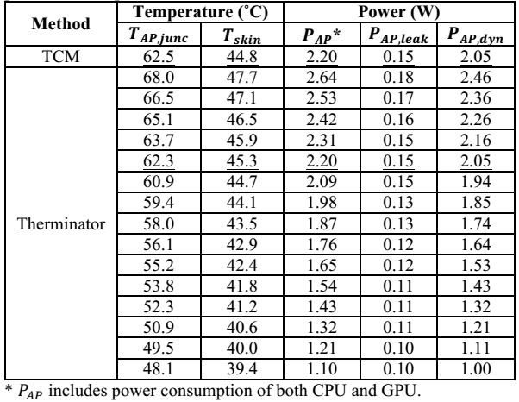
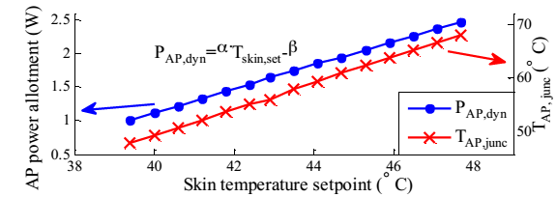
Effect of Skin Temperature Setpoint
Thermal management
  CPU, GPU, memory frequency throttling
  A feedback control with a skin temperature setpoint
    We observe frequency drops at 45˚C skin temperature
    AP junction temperature is 62.5˚C at that time
    Throttling invoked by skin temperature thermal governor

Slide 14
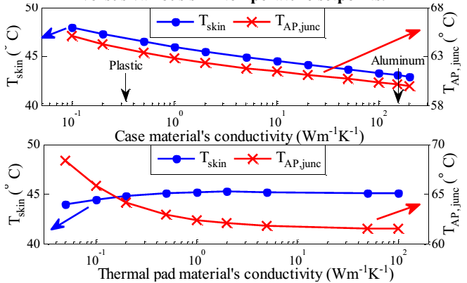
Effect of Device Material Composition
We also study the impact of material composition of
  Exterior case
    Galaxy S4 uses plastic case
  Thermal pad
    A thermal pad is placed on top of AP package

Slide 15
Conclusion
We implemented Therminator
  A thermal simulator producing accurate temperature maps for entire smartphones with a fast runtime
  Public available at http://atrak.usc.edu/downloads/packages/
Therminator is based on
  Compact thermal modeling
Therminator is validated against CFD tools
  Accurate
  Fast runtime
    GPU acceleration
Case study on Samsung Galaxy S4
  Linear relationship: performance vs T_{skin,set}
  To achieve higher performance
    High thermal conductive material for cases
    Low thermal conductive material for the thermal pad
Thank you for your attention!

Slide 16
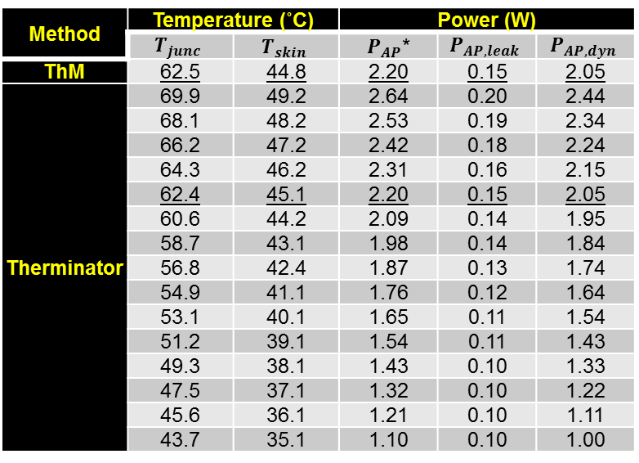
Case Study on Samsung Galaxy S4
  Considers P_{leak} vs T
  Linear perf vs T_{skin,set}
  Lower thermal conductive
  thermal pad is better!
Method | Temperature (˚C) |  | Power (W)
 | $$T_{junc}$$ | $$T_{skin}$$ | $P_{AP}$* | $$P_{AP,leak}$$ | $$P_{AP,dyn}$$
ThM | 62.5 | 44.8 | 2.20 | 0.15 | 2.05
Therminator | 69.9 | 49.2 | 2.64 | 0.20 | 2.44
 | 68.1 | 48.2 | 2.53 | 0.19 | 2.34
 | 66.2 | 47.2 | 2.42 | 0.18 | 2.24
 | 64.3 | 46.2 | 2.31 | 0.16 | 2.15
 | 62.4 | 45.1 | 2.20 | 0.15 | 2.05
 | 60.6 | 44.2 | 2.09 | 0.14 | 1.95
 | 58.7 | 43.1 | 1.98 | 0.14 | 1.84
 | 56.8 | 42.4 | 1.87 | 0.13 | 1.74
 | 54.9 | 41.1 | 1.76 | 0.12 | 1.64
 | 53.1 | 40.1 | 1.65 | 0.11 | 1.54
 | 51.2 | 39.1 | 1.54 | 0.11 | 1.43
 | 49.3 | 38.1 | 1.43 | 0.10 | 1.33
 | 47.5 | 37.1 | 1.32 | 0.10 | 1.22
 | 45.6 | 36.1 | 1.21 | 0.10 | 1.11
 | 43.7 | 35.1 | 1.10 | 0.10 | 1.00

