Slide 1
SIMES: A Simulator for
Hybrid Electrical Energy Storage Systems
Siyu Yue, Di Zhu, Yanzhi Wang, Younghyun Kim,
Naehyuck Chang, and Massoud Pedram

Slide 2
Background
Hybrid electrical energy storage (HEES) system
  Consists of several heterogeneous energy storage elements
  Exploits the strengths (such as high cycle efficiency, high power density, long cycle life, low cost, etc.) of each type of storage element and hide their weaknesses.
Some popular energy storage elements: Li-ion battery, lead-acid battery, Ni-Cd battery, supercapacitor, etc.

Slide 3

Background (cont’d)
Applications of HEES systems:
Electric vehicle
Home application
Mobile device
Notes:
HEES is proposed years ago and is gaining popularity recently. Researchers have proposed the application of HEES systems in various situations. For example, in home application, HEES system can be used to store energy during off-peak hours, or store excessive energy generated by PV cells. Others propose its application in electric vehicles to improve efficiency, increase lifetime and reduce cost. Some also propose its application in mobile devices to improve cycle efficiency to prolong battery life.
The vast number of research topics and issues on the design and management of HEES systems for different applications motivate the development of a powerful and scalable simulation platform. Therefore, we present SIMES, a simulator for HEES systems.

Slide 4
Abstraction of HEES Systems
Top-level: We abstract a HEES system as a graph:
  Source/load/bank/CTI => Nodes
  Converters => Edges
Connection between a component (node) and a converter (edge) is abstracted as a port, which is simply a V-I curve.
Notes:
To design a simulator for HEES systems, first we need to make an abstraction of HEES systems. At the top-level, we abstract a HEES system as a graph, which is straightforward. In this graph, we view all components other than converters as nodes, and converters as the edges connecting them.
The converters may include: DC-DC converters, AC-DC rectifier and DC-AC inverter.
Each converter has an input port and an output port. Converter determines the relationship between input/output voltage/current. Given any three of them, the other one can be calculated.

Slide 5
Modeling of HEES System Components
Modeling of the energy storage banks:
Open-circuit voltage as a function of state-of-charge
Internal resistance as a function of state-of-charge
Rate capacity effect
Self-discharge effect
State-of-health degradation (aging effect)
Fig 1. OCV and IR vs SoC curve of a lead-acid battery
Fig 2. Illustration of rate capacity effect
Notes:
We mainly focus on the modeling of energy storage banks in SIMES. To model an energy storage bank, we consider:
Fig 1 and 2 shows the curve fitting result of a lead-acid battery’s measurement data.

Slide 6
Modeling of HEES System Components
Modeling of converters:
Reflects input/output voltage and current relations
Fig 3. Power conversion efficiency of a converter.
Notes:
To model a converter we must determine the relationship among input and output voltage and current. Fig 3 shows the measurement result of a DC-DC converter’s input/output voltage/current relations. Note that power conversion efficiency is defined as output power divided by input power.

Slide 7
SIMES Overview
SIMES consists of three main modules:
1. Parser
  Parser parses the input XML file and constructs the HEES system.
2. Simulator
Simulator simulates the operation of the HEES system.
3. Visualizer
Visualizer can help user create the input XML file and visualize the output results.
Notes:
The user can interact with SIMES by writing the XML input file directly, or using Visualizer to create the XML input file. The user can also issue commands to simulator via command line.

Slide 8
Implementation of SIMES
Simulator runs adaptive time-step simulation.
At each time slot:
If it is a decision epoch, the main controller sets the input or output current of each converter.
Simulator calculates the current and voltage of each port.
The maximum time-step which is acceptable for every component with regard to precision requirement is determined.
Simulator simulates the operation of each component.

Slide 9
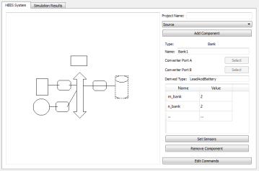
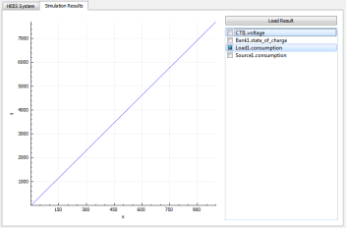
Implementation of SIMES
Visualizer is implemented using QT5.0 libraries.
Notes:
As shown in the figures, Visualizer has two functionalities. First, users can use it to “draw” the HEES system instead of taking the trouble to write the input XML file. Second, it can plot the simulation results.

Slide 10
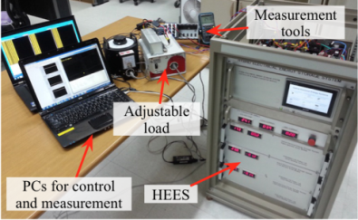
Validation of SIMES
We compare SIMES’s simulation result with a HEES system prototype.
Hardware Measurement Time | Simulator Runtime
30min | 1.1s
Fig 4. Simulation results vs. hardware measurement
Notes:
We use the CTI voltage and bank current as the input to SIMES and run the simulation. Fig 4 shows the measured voltage and simulated voltage, the average error of each bank’s voltage is less than 3%. This shows our model for the storage banks is accurate and SIMES works as expected. The runtime of SIMES is 1.1 second compared to the actual hardware measurement which takes 30 minutes.

Slide 11
Use Case Demonstration (1)
A single-family house equipped with a HEES system consisting of a Li-ion battery and lead-acid battery.
This system draws energy from the grid when the electricity price is low and supply energy to the grid when the price is high.
SIMES simulates the operation of such a system for one day and determine its efficiency.
Fig 5. SoC, current and voltage of both banks
Total energy drawn from the grid is 1575 Wh and supplied to the grid is 1266 Wh.
Overall efficiency: 80.4%
Notes:
(In case someone ask: runtime is 0.07 second, peak lasts 10 hours and off-peak is 14 hours, capacity of Li-ion battery is 26Ah, 24V rated terminal voltage, the capacity of lead-acid battery is 34Ah, rated terminal voltage is 24V.)

Slide 12
Use Case Demonstration (2)
A mobile device with a HEES system consisting of a Li-ion battery and supercapacitor.
An expert-based online management algorithm is implemented in the mobile device which determines how to charge/discharge the supercapacitor to minimize the power loss in the system.
SIMES simulates its operation and calculate the power consumption and power loss in the system. The baseline is using a Li-ion battery only as the power supply.
Fig 6. Power consumption and power loss of the mobile device
Power consumption is reduced by 4% and power loss is reduced by 28%.
Notes:
(In case someone asks: the runtime is 0.56s for HEES system and 0.29s for baseline system.)

Slide 13
Q&A

Slide 14
Thank You!

