Slide 1


Low Write-Energy STT-MRAMs using FinFET-based Access Transistors
Alireza Shafaei, Yanzhi Wang, and Massoud Pedram
Department of Electrical Engineering
University of Southern California
http://sportlab.usc.edu/

Slide 2
Outline
Introduction
  STT-MRAM
  FinFET Devices
FinFET-accessed STT-MRAM Cell
Comparison Results
  Cell-level Comparison
    Write Current under same Transistor (Channel) Width
    Cell Area under same Write Current Requirements
  Architecture-level Comparison
    Modified version of NVSim with FinFET support added

Slide 3
STT-MRAM
Spin-Transfer Torque Magnetic RAM (STT-MRAM) cell is composed of
  A magnetic storage element
  An access transistor
    NMOS transistor

Slide 4
Storage Element
Magnetic storage element
  Magnetic Tunnel Junction (MTJ)
  Free layer, fixed layer (reference
  layer), and insulating layer (MgO)
Magnetic direction can change
Free Layer
Insulating Layer
Fixed Layer
Magnetic direction is fixed
Parallel State
Low Resistance State (R_{P})
‘0’
Anti-Parallel State
High Resistance State (R_{AP})
‘1’
Notes:
An STT-MRAM cell is composed of a magnetic storage element, also known as the magnetic tunneling junction (MTJ), which is serially connected to an access transistor. The MTJ contains two ferromagnetic layers, fixed and free layers, which are separated by an insulating layer. While the fixed layer has a fixed magnetic direction, the free layer’s magnetic direction can be programmed to be either parallel (Figure 1(a)) or anti-parallel (Figure 1(b)) to the magnetic direction of the fixed layer, resulting in low (‘0’), RP , or high (‘1’), RAP , resistance states, respectively.

Slide 5
Read and Write Operations
Read operation: a small voltage difference is applied between BL and SL. The current will change based on the resistance of the MTJ.
Write operation: a large voltage difference is applied between BL and SL.
Ref.
Sense Amplifier
BL
+
-
WL
Access Transistor
SL
  I_{C} (critical switching current): minimum current that can change the state of the MTJ
  I_{R}: read current, I_{W}: write current
  Read stability: I_{R} < I_{C}
  Write-ability: I_{W} ≥ I_{C}
Notes:
To write into a cell, a high write current (I_{W}) is needed to successfully change the state of the MTJ cell (i.e., changing the free layer’s direction). This is achieved by applying a large voltage difference between source-line (SL) and bit-line (BL). Based on the polarity of this write voltage, MTJ is set to ‘0’ (for positive voltage) or ‘1’ (for negative voltage).
To read from a cell, a small voltage difference between SL and BL is applied. The resultant read current (I_{R}) is then compared to a reference current to determine the state of the MTJ (higher current reads-out ‘0’, whereas lower current reads-out ‘1’). The read voltage should be small enough such that it does not change the free layer’s magnetic direction (to ensure read stability, I_{R} < I_{C}), but large enough such that it produces a distinguishable current between low and high resistances.

Slide 6
STT-MRAM Features
Features
  Non-volatile memory
  Higher write endurance than PCM and Flash
  Low leakage
  CMOS compatible
  Immune to soft errors
Applications
  Universal memory
  Normally-off computing

Slide 7
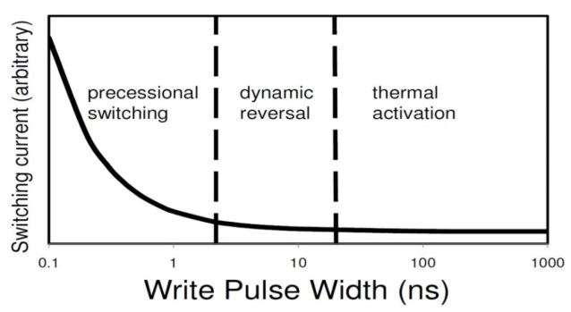
Challenge: Write Current
Write time = 10ns
Decreasing write time below 10ns
  Faster write
  Higher write current (exponential increase)
    Larger access transistor (W/L), and hence larger cell area
Therefore, key drawbacks of STT-MRAM are
  High write energy
  Long write latency
Layout area is restricted mainly by the NMOS access transistor width
Figure from A. Jog et al., “Cache revive: Architecting volatile STT-RAM caches for enhanced performance in CMPs,” DAC 2012.

Slide 8
FinFET Devices
Improved gate control (and lower impact of source and drain terminals) over the channel
  Reduces short channel effects
Higher ON current and smaller footprint compared with planar CMOS devices
Improved energy efficiency
Superior scalability
Higher immunity to random variations and soft errors
  L_{FIN}: fin (gate) length
  T_{SI}: fin width
  H_{FIN}: fin height
  W_{min}: effective channel width of a single fin (W_{min} ≈ 2 x H_{FIN})

Slide 9
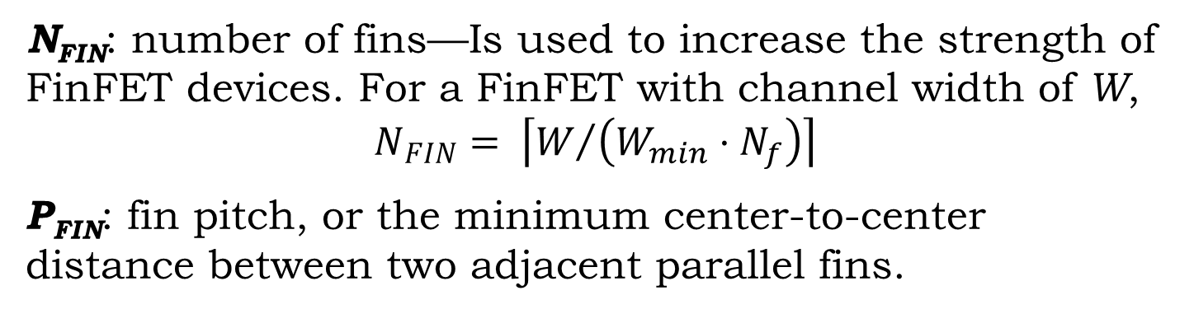
FinFET Layout
N_{FIN}: number of fins—Is used to increase the strength of FinFET devices. For a FinFET with channel width of W,
$$N_{FIN}= \left\lceil W/{\left(W_{min}⋅N_{f}\right)}\right\rceil$$
P_{FIN}: fin pitch, or the minimum center-to-center distance between two adjacent parallel fins.
Number of fingers

Slide 10
FinFET-accessed STT-MRAM
STT-MRAM needs a small access transistor that could deliver high ON currents
FinFET devices:
  The area (footprint) of a FinFET device may be reduced by increasing H_{FIN}, which is along the z-axis.
  FinFET offers higher ON current than CMOS transistors under the same channel width.
Use a FinFET device as the access transistor of the STT-MRAM
  No need for a separate and higher supply voltage

Slide 11
FinFET-specific Geometries
P_{FIN} depends on the underlying FinFET technology
  Lithography-defined technology
    Lithographic constraints limit the fin pitch spacing
  Spacer-defined technology
    Results in 2x reduction in the value of P_{FIN} at the cost of a more elaborate and costly lithographic process
H_{FIN} / T_{SI} = {1, 2, 3, 4}, depending on the etching technology.
Aggressive process technology

Slide 12
32nm FinFET Parameters
Parameter | Value | Comment
L_{FIN} | 35nm | Fin length
T_{SI} | 23nm | Silicon thickness
H_{FIN} | {23nm, 46nm, 69nm, 92nm} | fin height
P_{FIN} (lithography) | 80nm | Fin pitch in lithography-defined technology
P_{FIN} (spacer) | 40nm | Fin pitch in spacer-defined technology
W_{M} | 3λ = 48nm | Minimum width of metal wires
W_{M2M} | 3λ = 48nm | Minimum spacing between metal wires
W_{C} | 2λ = 32nm | Minimum contact size
W_{G2C} | 2λ = 32nm | Minimum spacing between gate and contact
M. Alioto, “Comparative Evaluation of Layout Density in 3T, 4T, and MT FinFET Standard Cells,” IEEE Trans. on VLSI Systems, 19(5):751–762, 2011.
Notes:
Process design rules are similar for FinFET and CMOS technologies (their difference is in the fin fabrication, which does not influence design rules)

Slide 13
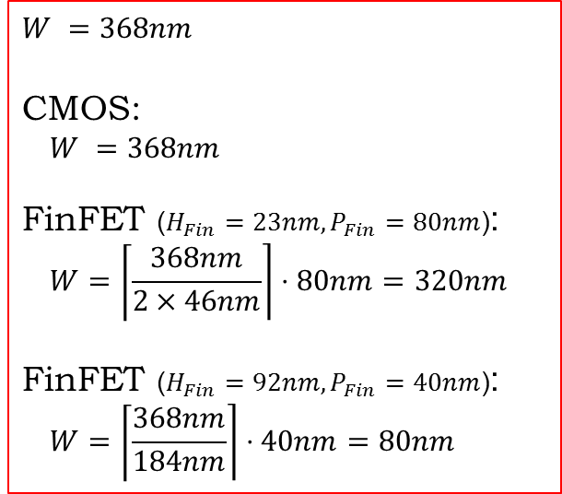
FinFET Area
Layouts of a transistor with channel width of W in planar CMOS and FinFET process technologies:
$$W =368nm$$
CMOS:
$$W =368nm$$
FinFET ($H_{Fin}=23nm, P_{Fin}=80nm$):
$$W=\left\lceil \frac{368nm}{2×46nm}\right\rceil ⋅80nm=320nm$$
FinFET ($H_{Fin}=92nm, P_{Fin}=40nm$):
$$W=\left\lceil \frac{368nm}{184nm}\right\rceil ⋅40nm=80nm$$
Planar CMOS
FinFET
A FinFET device is more compact than the CMOS counterpart, since its channel width can be adjusted by the fin height without impacting the device area.

Slide 14
FinFET-accessed STT-MRAM Layouts
Single Finger
Two Fingers
Cell width is constrained by metal design rules (due to parallel metal wires)
Cell width is constrained by the number of fins (if N_{FIN} is large enough)
Metal-Constrained
Fin-Constrained

Slide 15
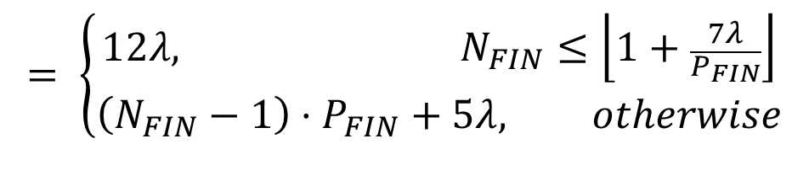
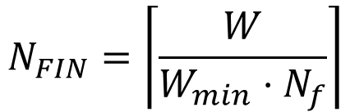

Cell Width
MC: Metal-Constrained, FC: Fin-Constrained
$$W_{MC}=2×W_{M}+2×W_{M2M}=12λ$$
$$W_{FC}=\left(N_{FIN}−1\right)⋅P_{FIN}+W_{C}+W_{M2M}=\left(N_{FIN}−1\right)⋅P_{FIN}+5λ$$
$$W_{Cell}=max\left(W_{MC}, W_{FC}\right)$$
$$= \left\{\begin{aligned}12λ, N_{FIN}≤\left\lfloor 1+\frac{7λ}{P_{FIN}}\right\rfloor \\ &\left(N_{FIN}−1\right)⋅P_{FIN}+5λ, otherwise\end{aligned}\right.$$
$$N_{FIN}=\left\lceil \frac{W}{W_{min}⋅N_{f}}\right\rceil$$

Slide 16

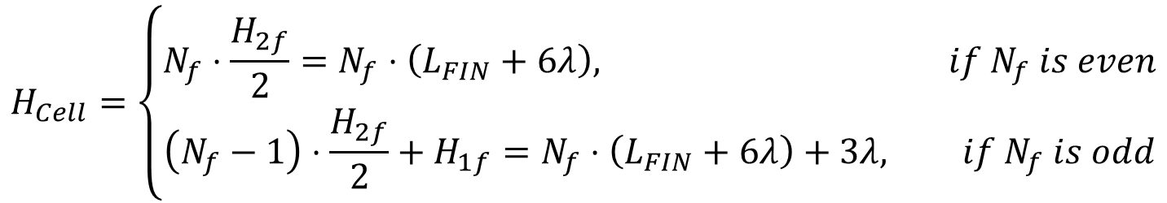
Cell Height
The number of fingers ($N_{f}$) is the main factor that determines the cell height
$$H_{1f}=L_{FIN}+W_{C}+\frac{W_{M}}{2}+\frac{W_{M2M}}{2}+2×W_{G2C}=L_{FIN}+9λ$$
$$H_{2f}={2×L}_{FIN}+{2×W}_{C}+4×W_{G2C}={2×L}_{FIN}+12λ$$
$$H_{Cell}=\left\{\begin{aligned}N_{f}⋅\frac{H_{2f}}{2}=N_{f}⋅\left(L_{FIN}+6λ\right), if N_{f} is even \\ &\left(N_{f}−1\right)⋅\frac{H_{2f}}{2}+H_{1f}=N_{f}⋅\left(L_{FIN}+6λ\right)+3λ, if N_{f} is odd\end{aligned}\right.$$

Slide 17
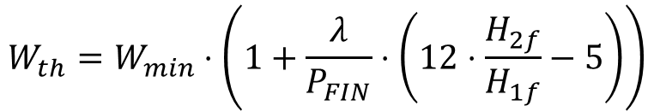
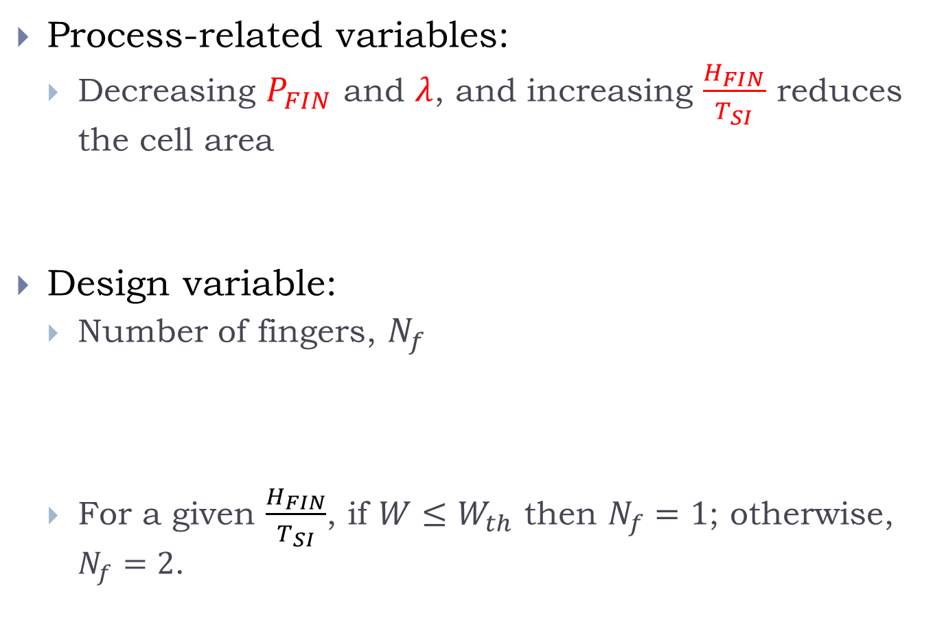
Optimization Variables
Process-related variables:
  Decreasing $P_{FIN}$ and $λ$, and increasing $\frac{H_{FIN}}{T_{SI}}$ reduces the cell area
Design variable:
  Number of fingers, $N_{f}$
  For a given $\frac{H_{FIN}}{T_{SI}}$, if ${W≤W}_{th}$ then $N_{f}=1$; otherwise, $N_{f}=2$.
Technology node
FinFET technology
Etching technology
Threshold transistor
width
$$W_{th}=W_{min}⋅\left(1+\frac{λ}{P_{FIN}}⋅\left(12⋅\frac{H_{2f}}{H_{1f}}−5\right)\right)$$

Slide 18


Minimum Cell Area (1)
$$N_{f}=1$$
$$N_{f}=2$$

Slide 19
Minimum Cell Area (2)
Strict
Moderate
Aggressive
Strict, moderate, and aggressive FinFET technologies on average reduce the cell area by 11%, 37%, and 48%, respectively, compared with bulk CMOS results, for the range of transistor widths shown in the figure.

Slide 20
Cell-level Comparison
Comparing cell area of FinFET- vs. MOS-accessed STT-MRAM cells under the same write current requirements
  32nm PTM (bulk CMOS and FinFET)

Slide 21
Write Current
Write currents of FinFET- vs. MOS-accessed STT-MRAM cells for different transistor widths in 32 nm PTM, considering worst-case corner of process variations (PV)
For a given width, a FinFET device delivers higher ON current (~28%) than the CMOS counterpart
Param. | Variation
V_{th} of FinFET | 2.5%
V_{th} of CMOS | 5%
MTJ resistance | 10%

Slide 22
Minimum Cell Area under same Write Current Requirements (1)
An STT-MRAM cell requires a specific write current in order to change its internal state, which is the main requirement of the cell (the access transistor width is the effect of this requirement).
Hence, area comparison of FinFET- vs. MOS-accessed STT-MRAM cells should be done under the same write current.
FinFET area remains unchanged

Slide 23
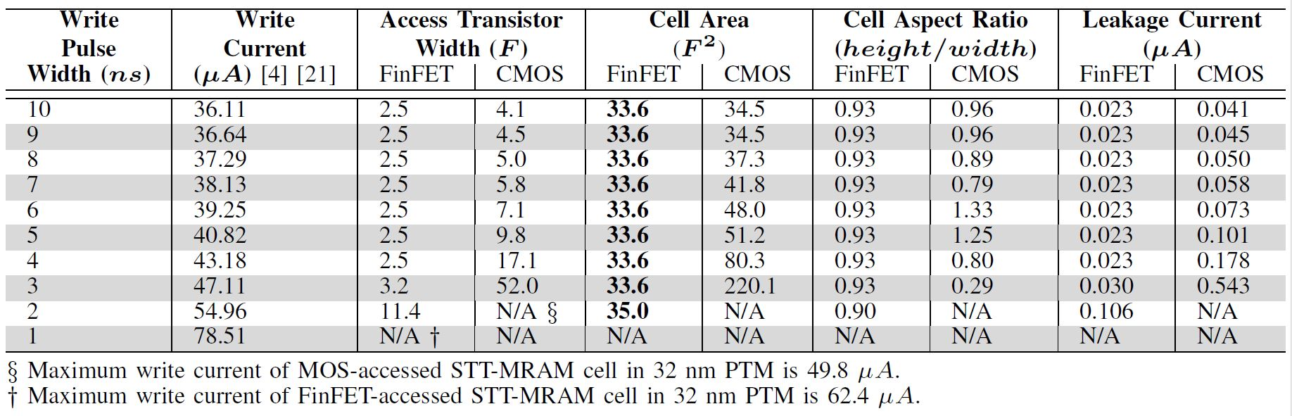
Minimum Cell Area under same Write Current Requirements (2)
More compact layout and higher ON current are two features of FinFET devices that lead to significant area reduction in STT-MRAM cells.
Table I

Slide 24
Architecture-level Comparison (1)
NVSim
  A circuit-level model for emerging nonvolatile memories
FinFET support is added to NVSim
  FinFET-specific process parameters from MASTAR tool for 32nm double-gate technology
  Capacitance calculations from BSIM-CMG (compact models for multi-gate devices)
  ON and OFF currents of FinFET and CMOS transistors calculated in HSpice using 32nm PTM, for temperatures from 300K to 400K
  STTMRAM cell configurations updated based on the results of Table I

Slide 25
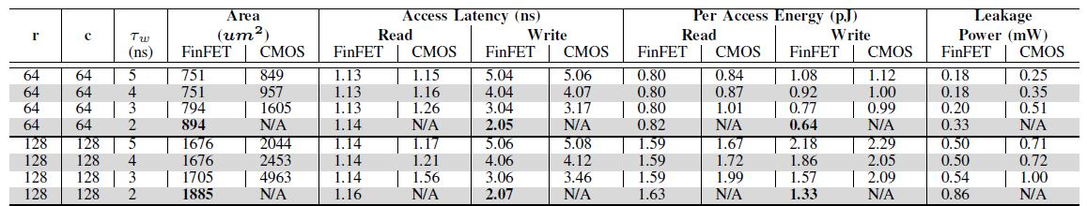
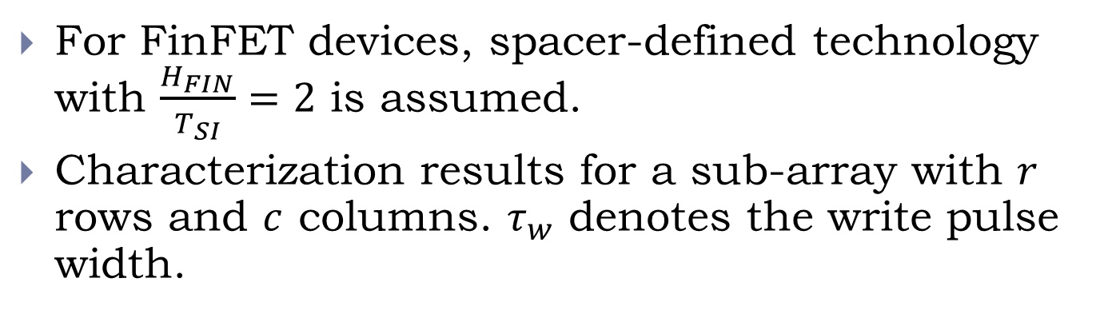
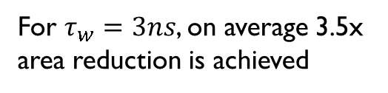
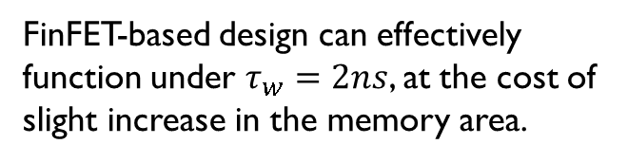
Architecture-level Comparison (2)
For FinFET devices, spacer-defined technology with $\frac{H_{FIN}}{T_{SI}}=2$ is assumed.
Characterization results for a sub-array with $r$ rows and $c$ columns. $τ_{w}$ denotes the write pulse width.
For $τ_{w}=3ns$, on average 3.5x area reduction is achieved
FinFET-based design can effectively function under $τ_{w}=2ns$, at the cost of slight increase in the memory area.

Slide 26
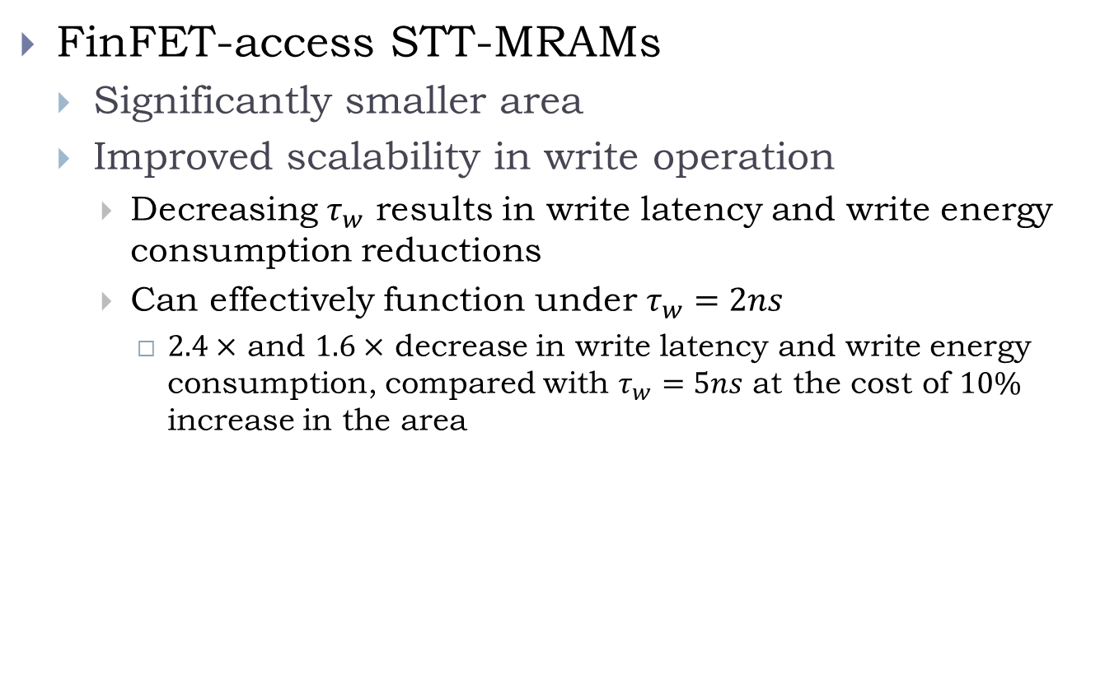
Conclusion
FinFET-access STT-MRAMs
  Significantly smaller area
  Improved scalability in write operation
    Decreasing $τ_{w}$ results in write latency and write energy consumption reductions
    Can effectively function under $τ_{w}=2ns$
      $2.4×$ and $1.6×$ decrease in write latency and write energy consumption, compared with $τ_{w}=5ns$ at the cost of $10\%$ increase in the area

