Slide 1




Minimizing the Energy-Delay Product of SRAM Arrays using a Device-Circuit-Architecture Co-Optimization Framework
Alireza Shafaei, Hassan Afzali-Kusha, and Massoud Pedram
Department of Electrical Engineering
University of Southern California
http://sportlab.usc.edu/

Slide 2
Outline
Introduction
  6T SRAM cell with HVT devices
Read/write-assist techniques
SRAM array model
Simulation results
Conclusion
1

Slide 3




6T SRAM Cell
Read stability (non-destructive read) requirement:
Write-ability (successful write) requirement:
Can easily fail under process variations
  Sizing up transistors or adopting more robust SRAM cells (e.g., 8T) come at the cost of larger layout area
  Width quantization property in FinFETs
    Ideal case: single-fin devices for all transistors
$$I_{ON,M5}<I_{ON,M1}$$
$$I_{ON,M6}<I_{ON,M2}$$
$$I_{ON,M5}>I_{ON,M3}$$
$$I_{ON,M6}>I_{ON,M4}$$
PD: Pull-down transistors (M1 and M2)
PU: Pull-up transistors (M3 and M4)
AC: Access transistors (M5 and M6)
2

Slide 4
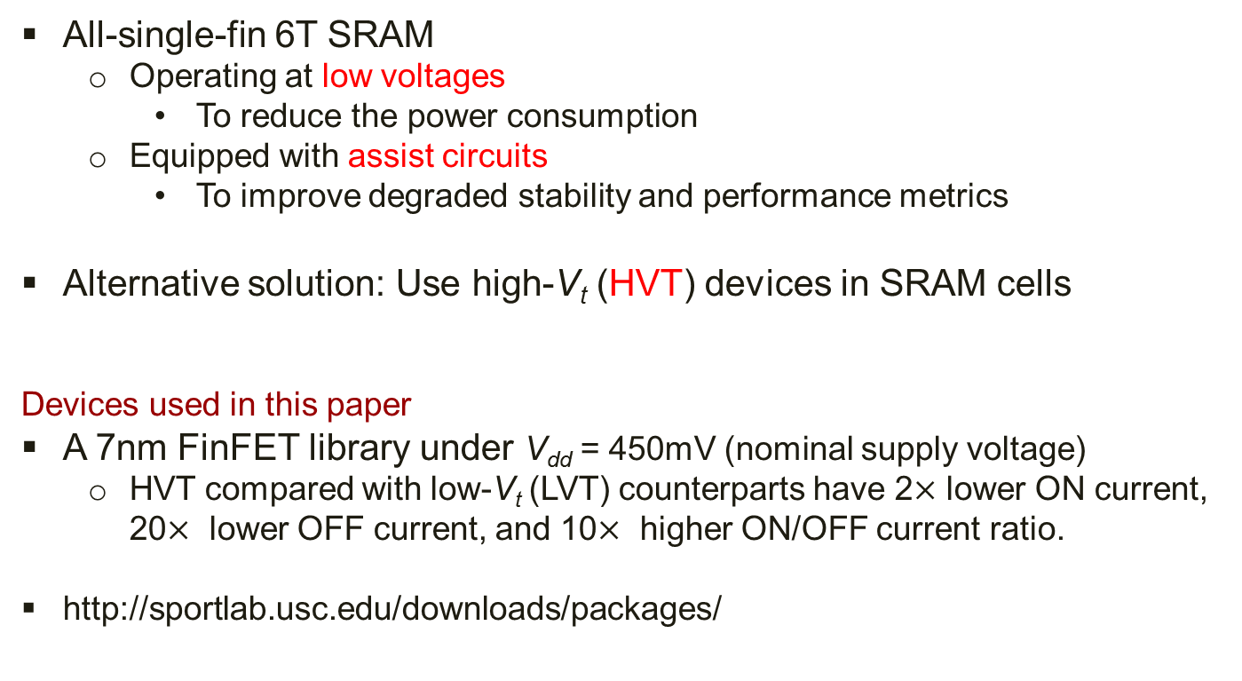
Area/Power-Efficient SRAMs
All-single-fin 6T SRAM
  Operating at low voltages
    To reduce the power consumption
  Equipped with assist circuits
    To improve degraded stability and performance metrics
Alternative solution: Use high-V_{t} (HVT) devices in SRAM cells
Devices used in this paper
A 7nm FinFET library under V_{dd} = 450mV (nominal supply voltage)
  HVT compared with low-V_{t} (LVT) counterparts have 2$×$ lower ON current, 20$×$ lower OFF current, and 10$×$ higher ON/OFF current ratio.
http://sportlab.usc.edu/downloads/packages/
3

Slide 5
6T SRAM with HVT Devices
Advantages of using HVT devices in SRAM cells:
  Lower OFF current → significant leakage power reduction
  Higher ON/OFF → static noise margin (SNM) improvement
Major drawback:
  Lower ON current → reduces the read current → increases the bitline (BL) delay → performance degradation
4

Slide 6

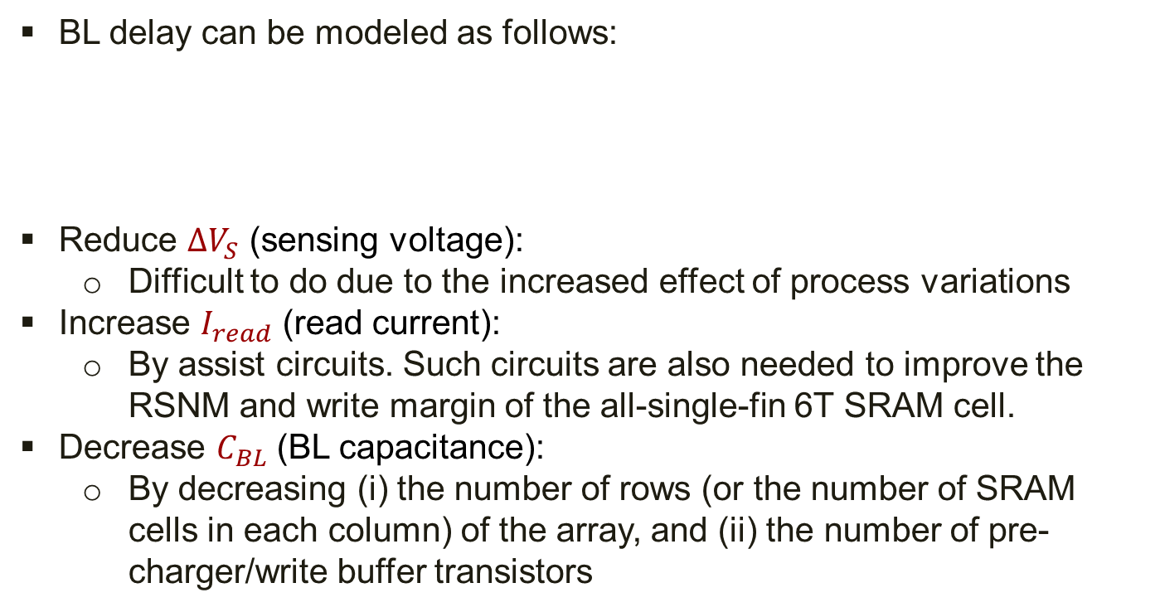
Mitigating the BL Delay
BL delay can be modeled as follows:
Reduce $ΔV_{S}$ (sensing voltage):
  Difficult to do due to the increased effect of process variations
Increase $I_{read}$ (read current):
  By assist circuits. Such circuits are also needed to improve the RSNM and write margin of the all-single-fin 6T SRAM cell.
Decrease $C_{BL}$ (BL capacitance):
  By decreasing (i) the number of rows (or the number of SRAM cells in each column) of the array, and (ii) the number of pre-charger/write buffer transistors
$$t_{BL}=\frac{C_{BL}⋅ΔV_{S}}{I_{read}}$$
5

Slide 7
Read-Assist Techniques
Effective in improving RSNM
Effective in reducing BL delay
6

Slide 8
Write-Assist Techniques
WL overdrive: VWL is set to a voltage level higher than Vdd to strongly turn on the access transistor.
Negative BL: Write operation into the SRAM cell conventionally (without write-assist) occurs from a BL that is 0. By using a negative voltage for that BL, the gate-to-source voltage becomes larger, more strongly turning on the access transistor.
7

Slide 9
SRAM Array Model
Cell V_{dd}
Cell V_{ss}
8

Slide 10





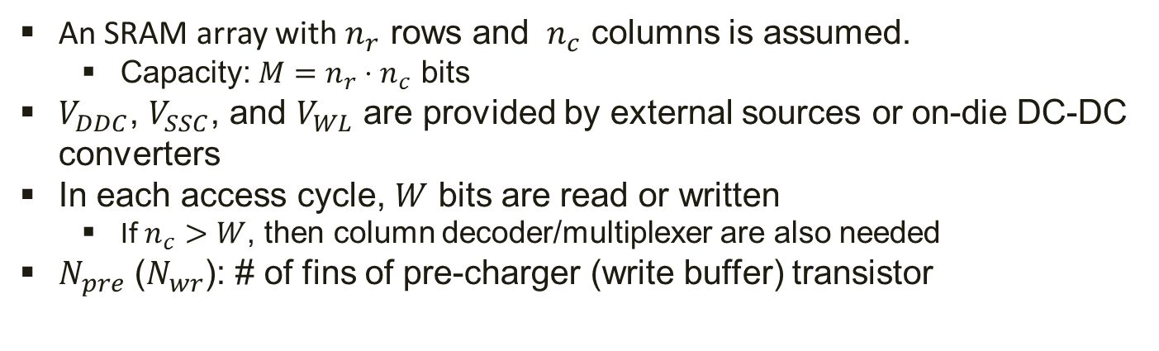






SRAM Array Model (2)
An SRAM array with $n_{r}$ rows and $n_{c}$ columns is assumed.
  Capacity: $M=n_{r}⋅n_{c}$ bits
$V_{DDC}$, $V_{SSC}$, and $V_{WL}$ are provided by external sources or on-die DC-DC converters
In each access cycle, $W$ bits are read or written
  If $n_{c}>W$, then column decoder/multiplexer are also needed
$N_{pre}$ ($N_{wr}$): # of fins of pre-charger (write buffer) transistor
$$D=\frac{C⋅ΔV}{I}$$
$$E_{sw}=V⋅I⋅D=C⋅V⋅ΔV$$
Tables 1, 2, and 3 in the paper
$$D_{array}=max⁡(D_{rd},D_{wr})$$
$D_{rd}$ ($D_{wr}$): read (write) access delay
$E_{sw,rd}$ ($E_{sw,wr}$): read (write) access energy
$$E_{array,sw}=β⋅E_{sw,rd}+\left(1−β\right)⋅E_{sw,wr}$$
$β$: ratio of read access to the total access
$$E_{array,leak}=M⋅P_{leak,sram}⋅D_{array}$$
$α$: array activity factor
$$E_{array}=α⋅E_{array,sw}+E_{array,leak}$$
$P_{leak,sram}$: leakage power of an SRAM cell
9

Slide 11
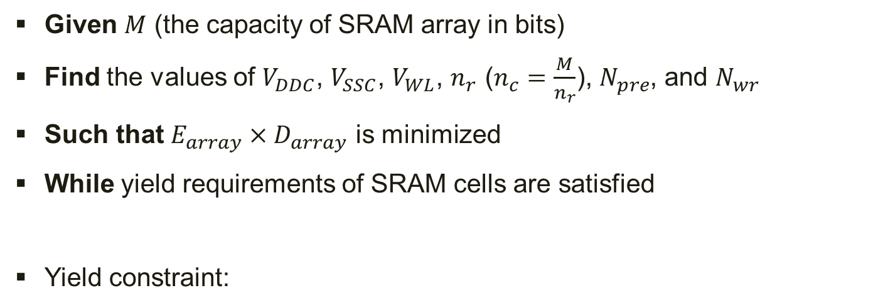



Optimization Problem
Given $M$ (the capacity of SRAM array in bits)
Find the values of $V_{DDC}$, $V_{SSC}$, $V_{WL}$, $n_{r}$ ($n_{c}=\frac{M}{n_{r}}$), $N_{pre}$, and $N_{wr}$
Such that $E_{array}×D_{array}$ is minimized
While yield requirements of SRAM cells are satisfied
Yield constraint:
$$\min\left({\left(μ−kσ\right)}_{HSNM},{\left(μ−kσ\right)}_{RSNM},{\left(μ−kσ\right)}_{WM}\right)≥0$$
$$\min\left(HSNM, RSNM, WM\right)≥δ$$
$1≤k≤6$, depending on yield requirements
$δ$: the minimum acceptable noise margin level
10

Slide 12
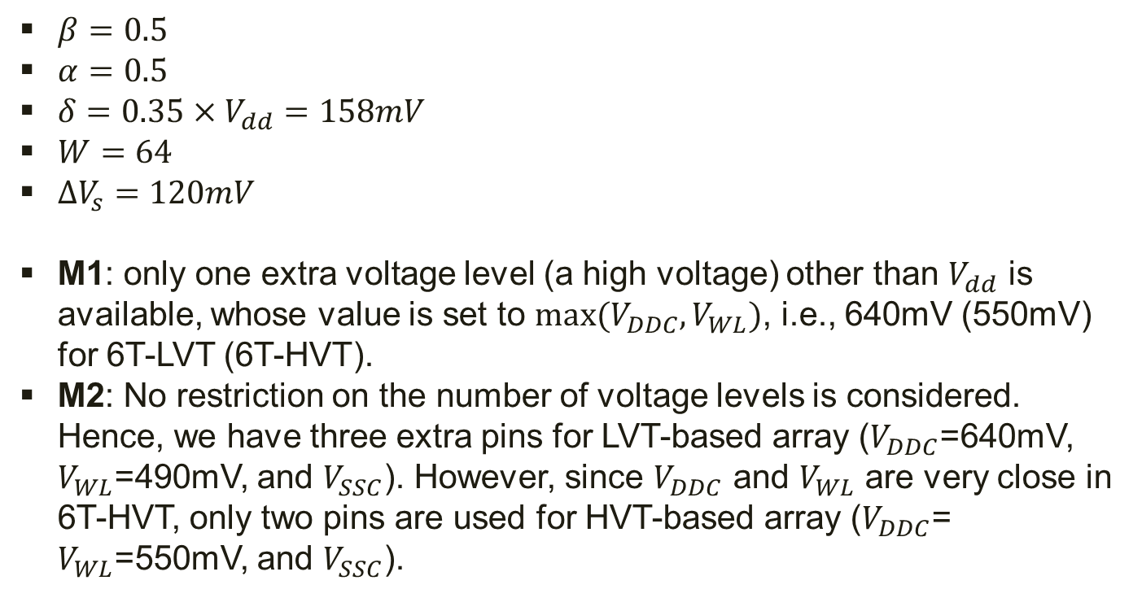
Simulation Setup
$β=0.5$
$α=0.5$
$δ=0.35×V_{dd}=158mV$
$W=64$
$ΔV_{s}=120mV$
M1: only one extra voltage level (a high voltage) other than $V_{dd}$ is available, whose value is set to ${max⁡(V}_{DDC},V_{WL})$, i.e., 640mV (550mV) for 6T-LVT (6T-HVT).
M2: No restriction on the number of voltage levels is considered. Hence, we have three extra pins for LVT-based array ($V_{DDC}$=640mV, $V_{WL}$=490mV, and $V_{SSC}$). However, since $V_{DDC}$ and $V_{WL}$ are very close in 6T-HVT, only two pins are used for HVT-based array ($V_{DDC}$= $V_{WL}$=550mV, and $V_{SSC}$).
11

Slide 13
Simulation Results: Delay
12

Slide 14
Simulation Results: Delay
13

Slide 15
Simulation Results: Energy
14

Slide 16

Simulation Results: Delay$×$Energy
15

Slide 17
Conclusion
By using the proposed optimization framework, for SRAM array capacities ranging from 1KB to 16KB, on average 59% lower energy-delay product with maximum 12% (and on average 9%) performance penalty is achieved.
16

Slide 18
Thanks!

